Slide 1
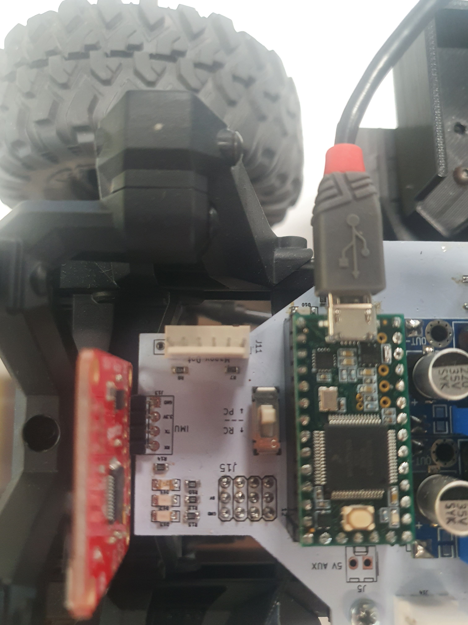
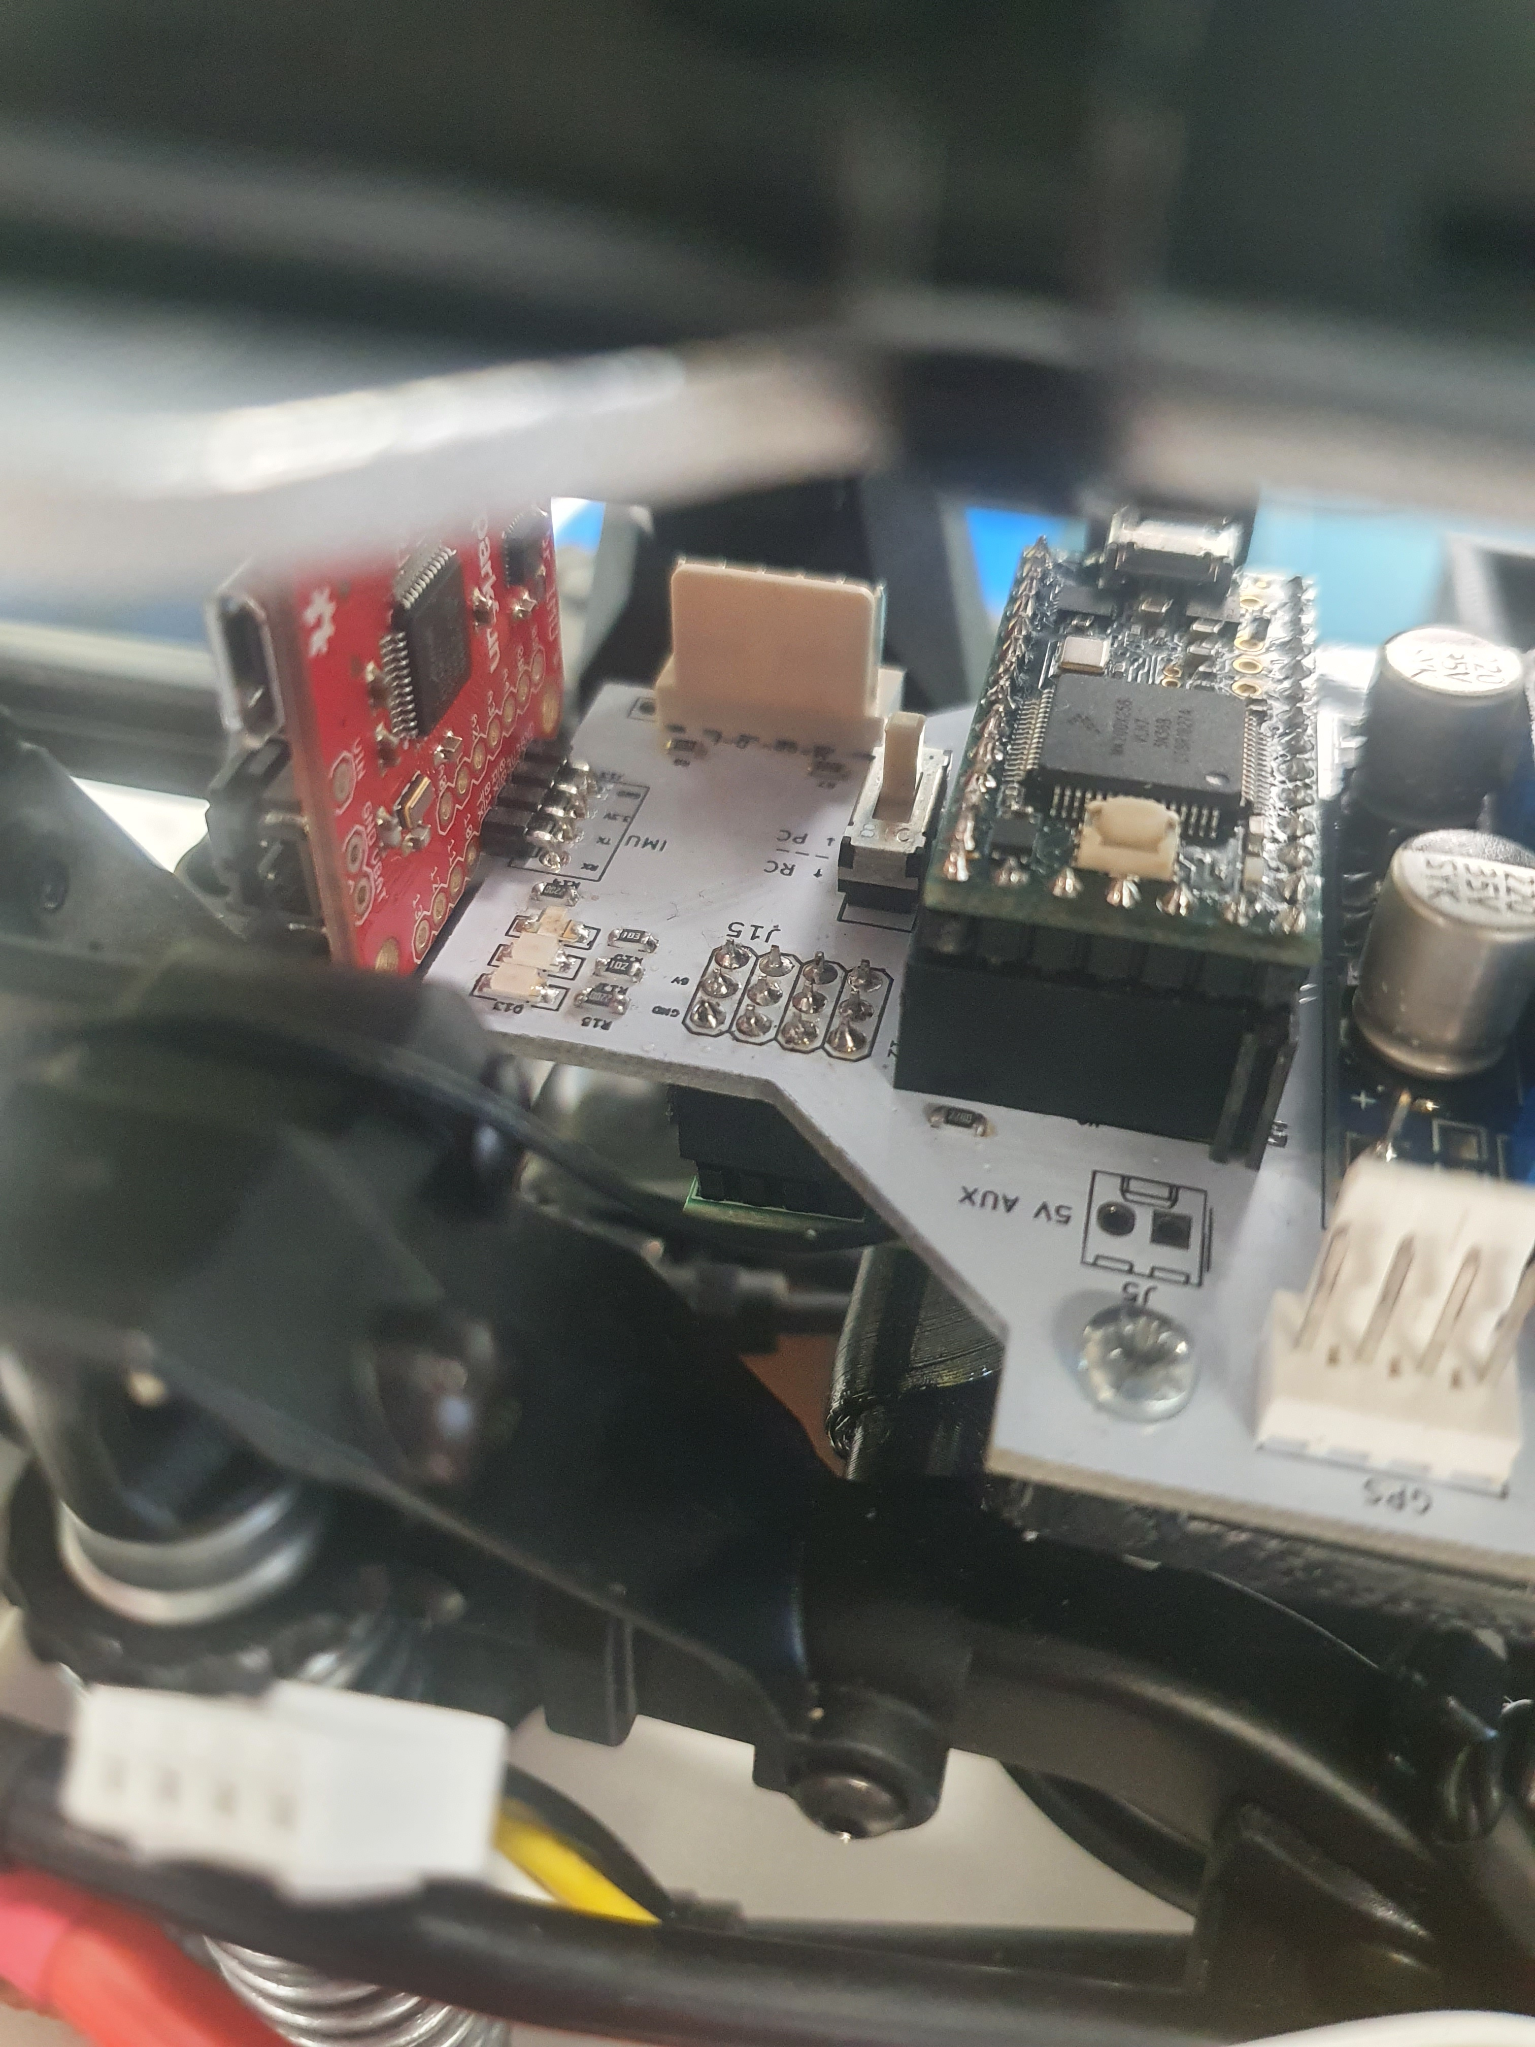
PC/RC Mode Switch

Slide 2
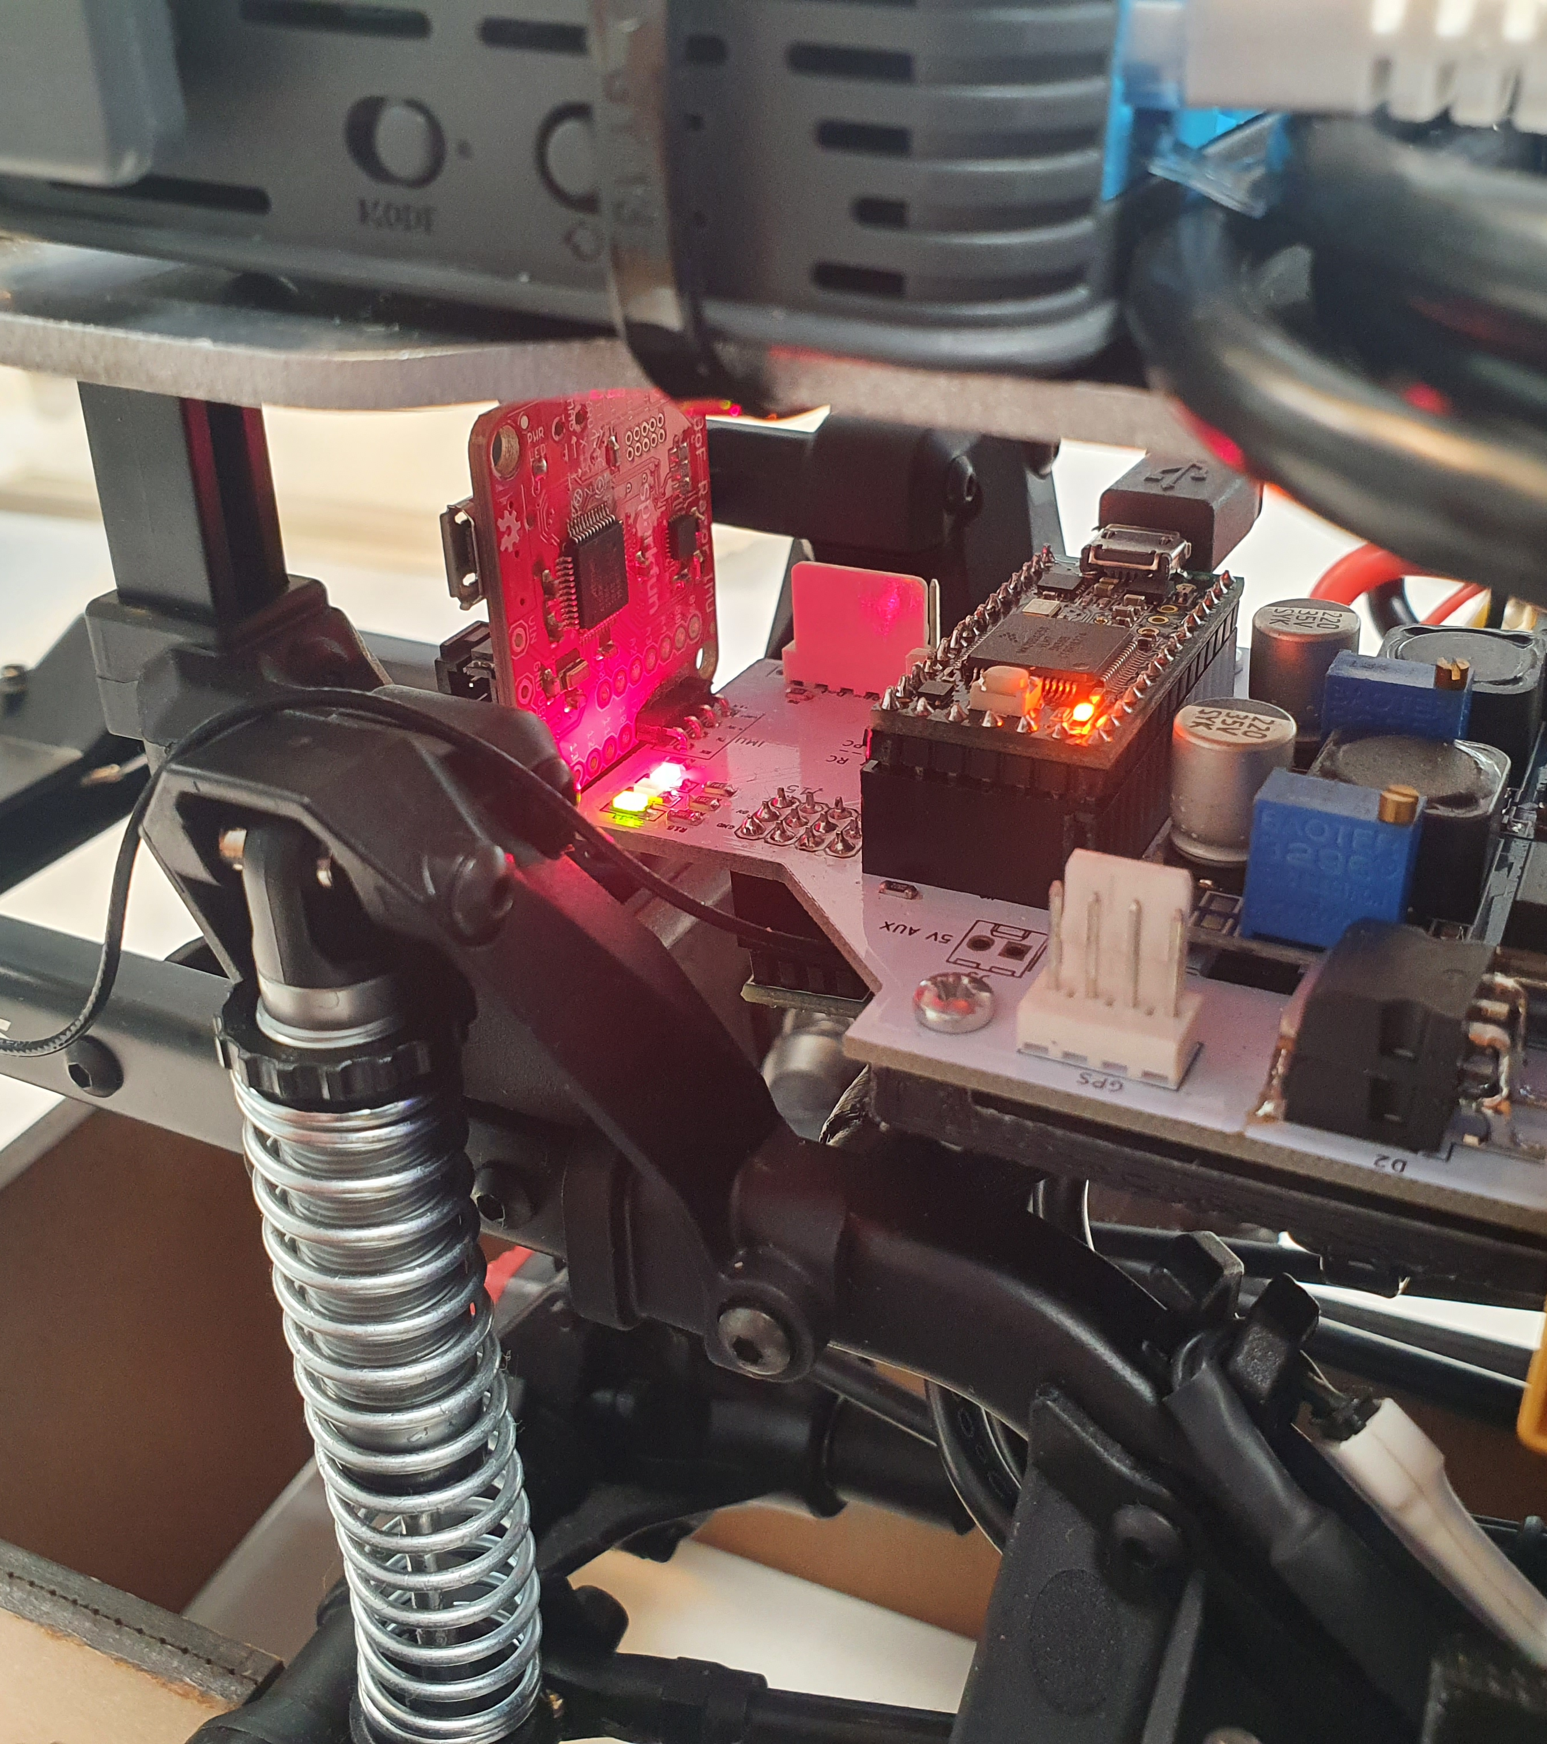
Movement Disabled
Comms Failure
Heart Beat

Slide 3
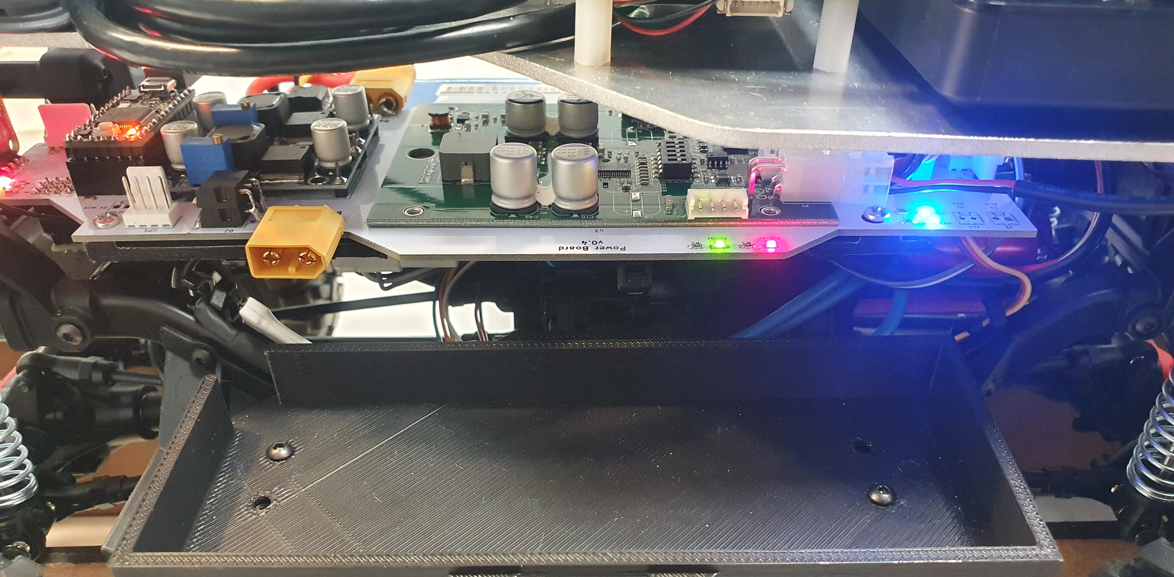
6V Aux Power
5V Aux Power

Slide 4
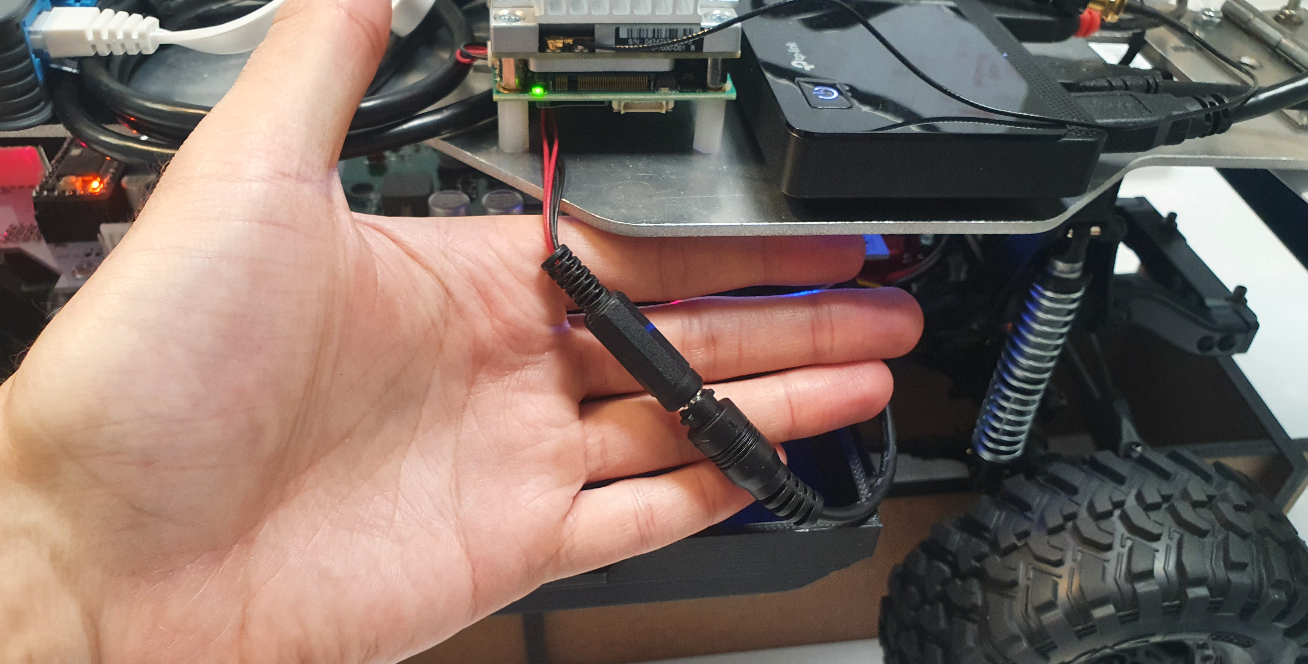
12V Aux Power
Create Intermediate Cable

Slide 5
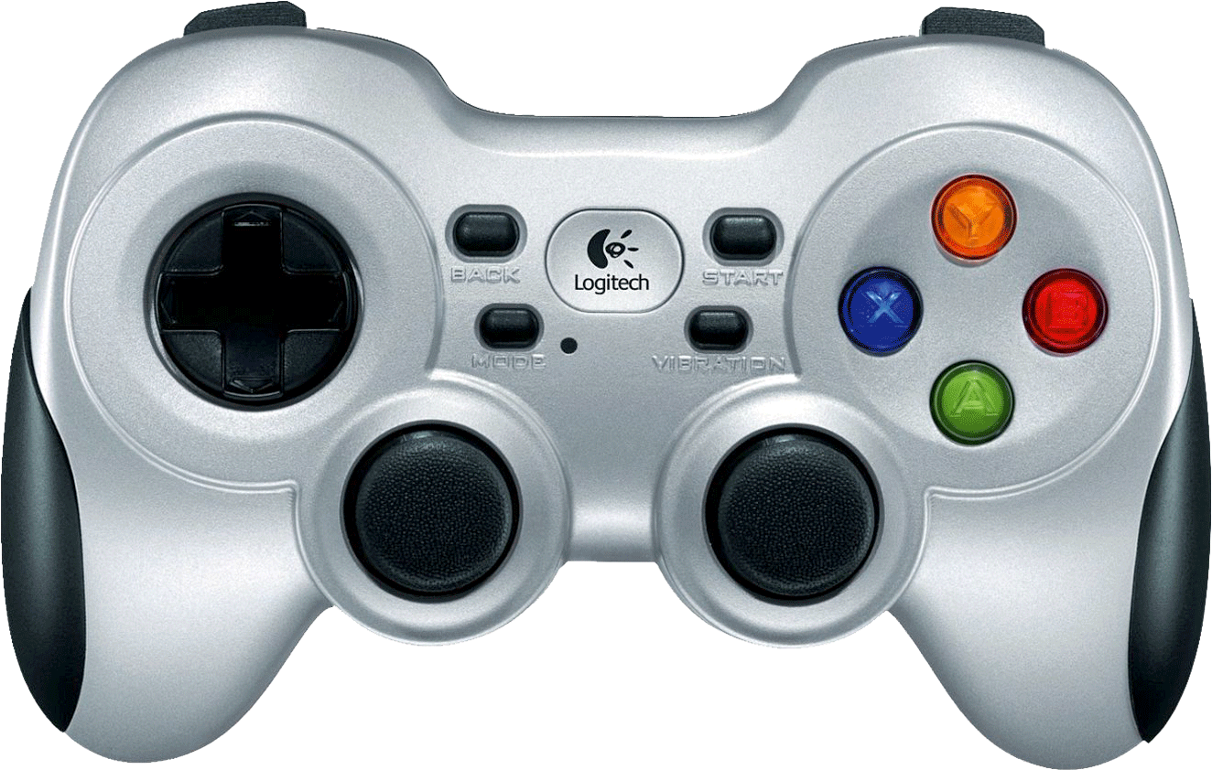
LB
Hold for Autonomous Deadman Switch
RB
Hold for Teleop
Deadman Switch
Left Joystick Teleop Velocity
Right Joystick Teleop Steering

Slide 6
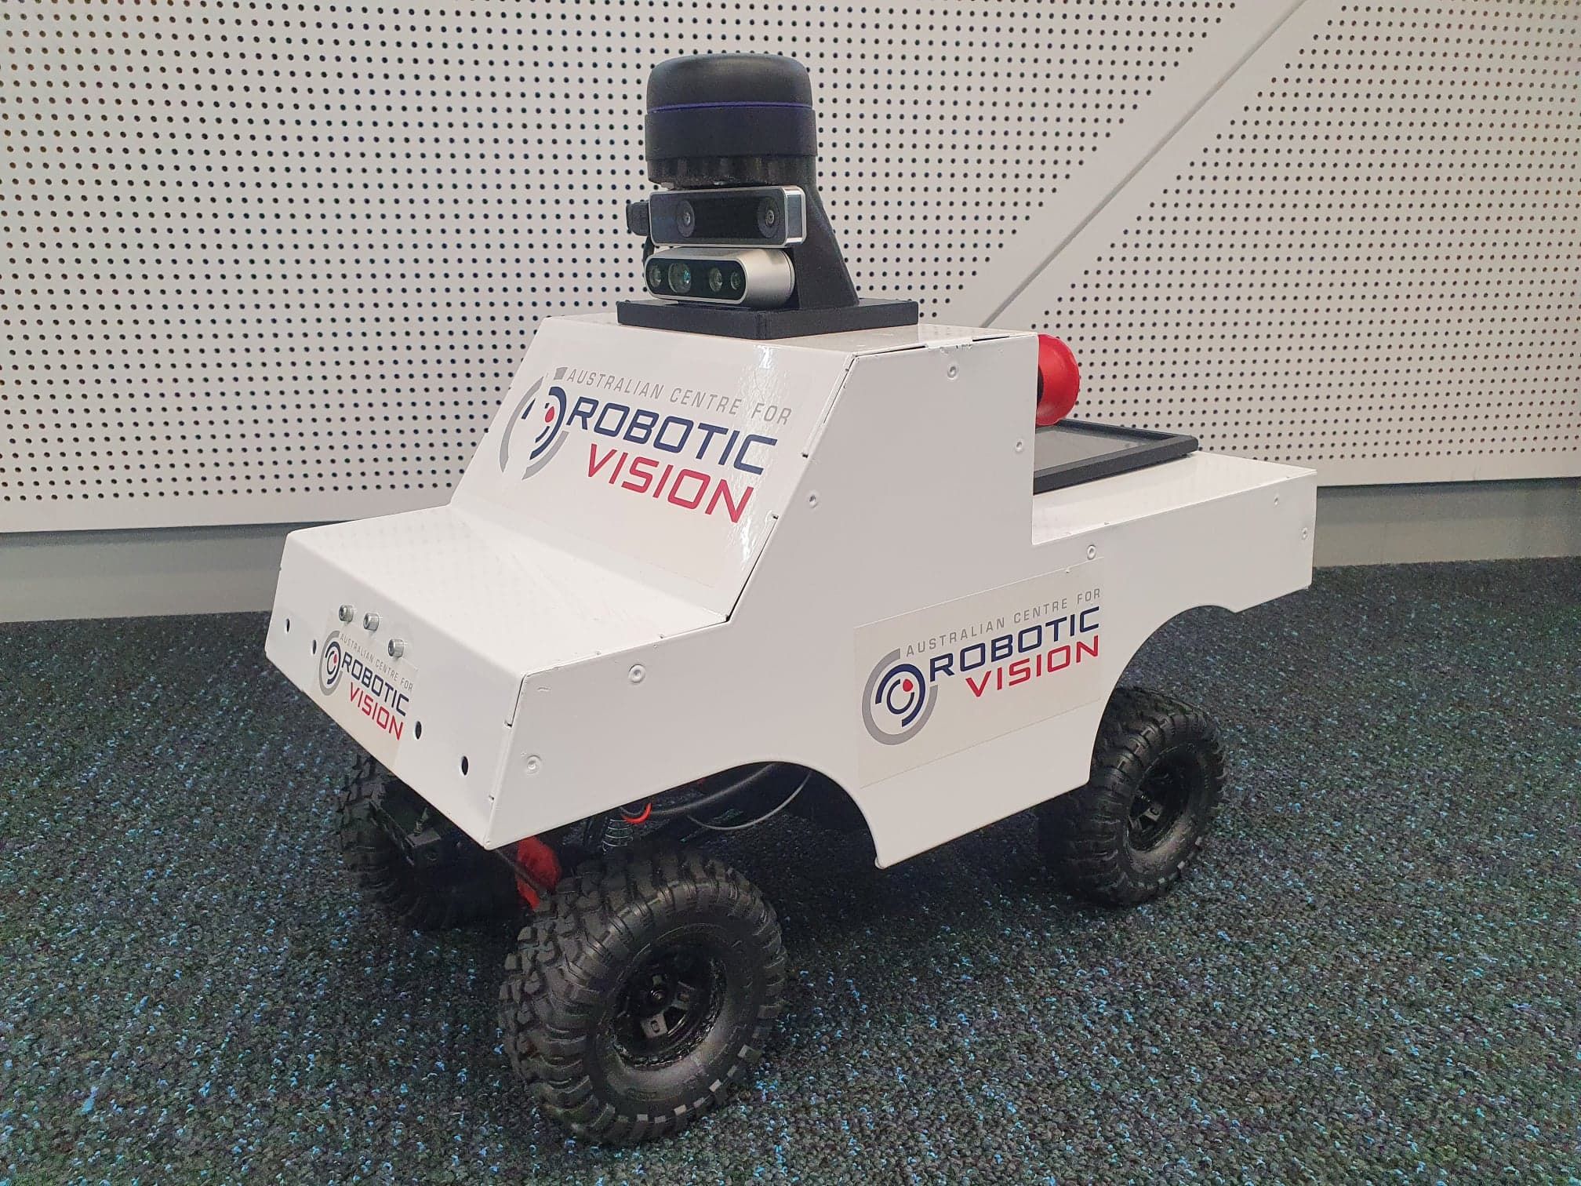
Z
X
Y

